Slide 1


HARDWARE.astronomy
Housekeeping Box
(H.aHk Box)
Adam Stammer
Under the Direction of Dr. Carl Ferkinhoff

Slide 2
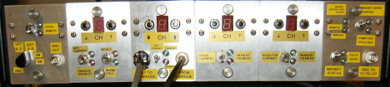
Motivations
Proprietary Design/Obsolete Internal Chips
Multiplexer Readout Rate Limit
Dependent On PC

Slide 3
Abstract Goals
Open Source
Versatile
Cheap
Modular Card System
Design Steps
Prototyping Daughtercard (P-Card)
Backplane
Programming Controllers
Chassis and Accompanying Components
ZEUS2 Daughtercards
Goals

Slide 4
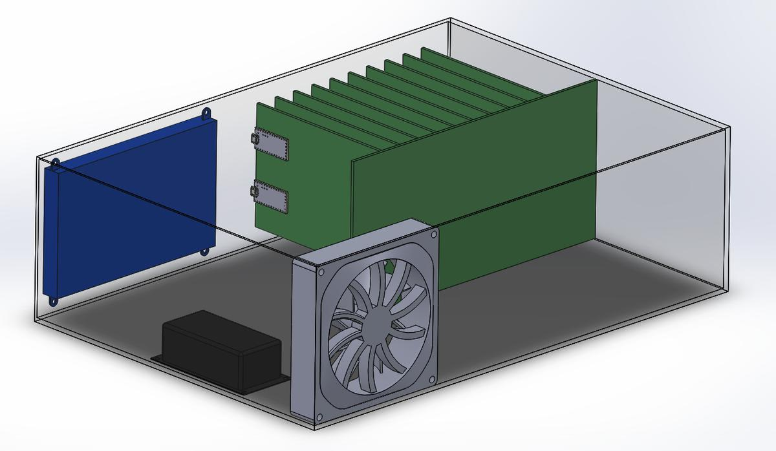
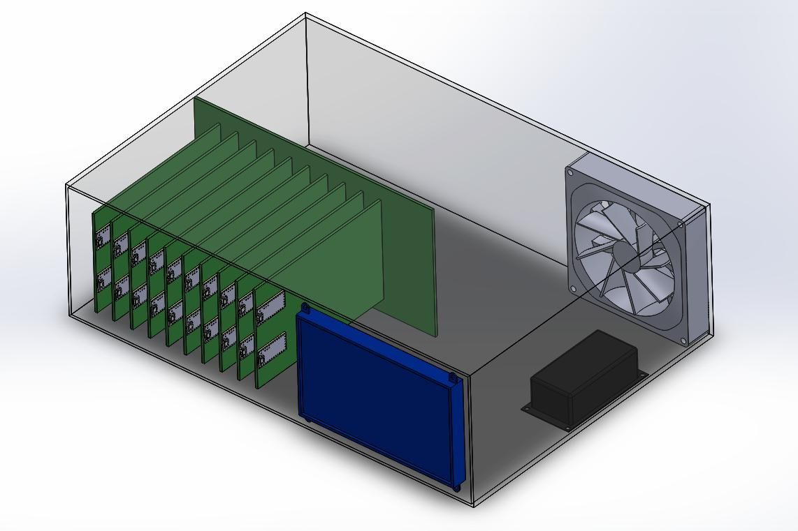
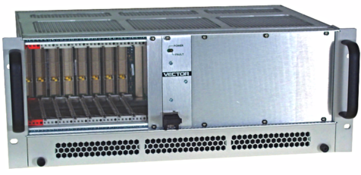
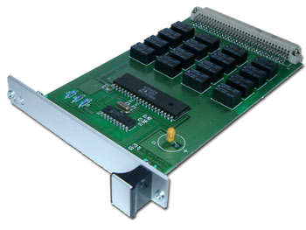
Draft Render and Similar Products
Touch Screen
Backplane & Daughtercards
Cooling Fan
Power Supply

Slide 5
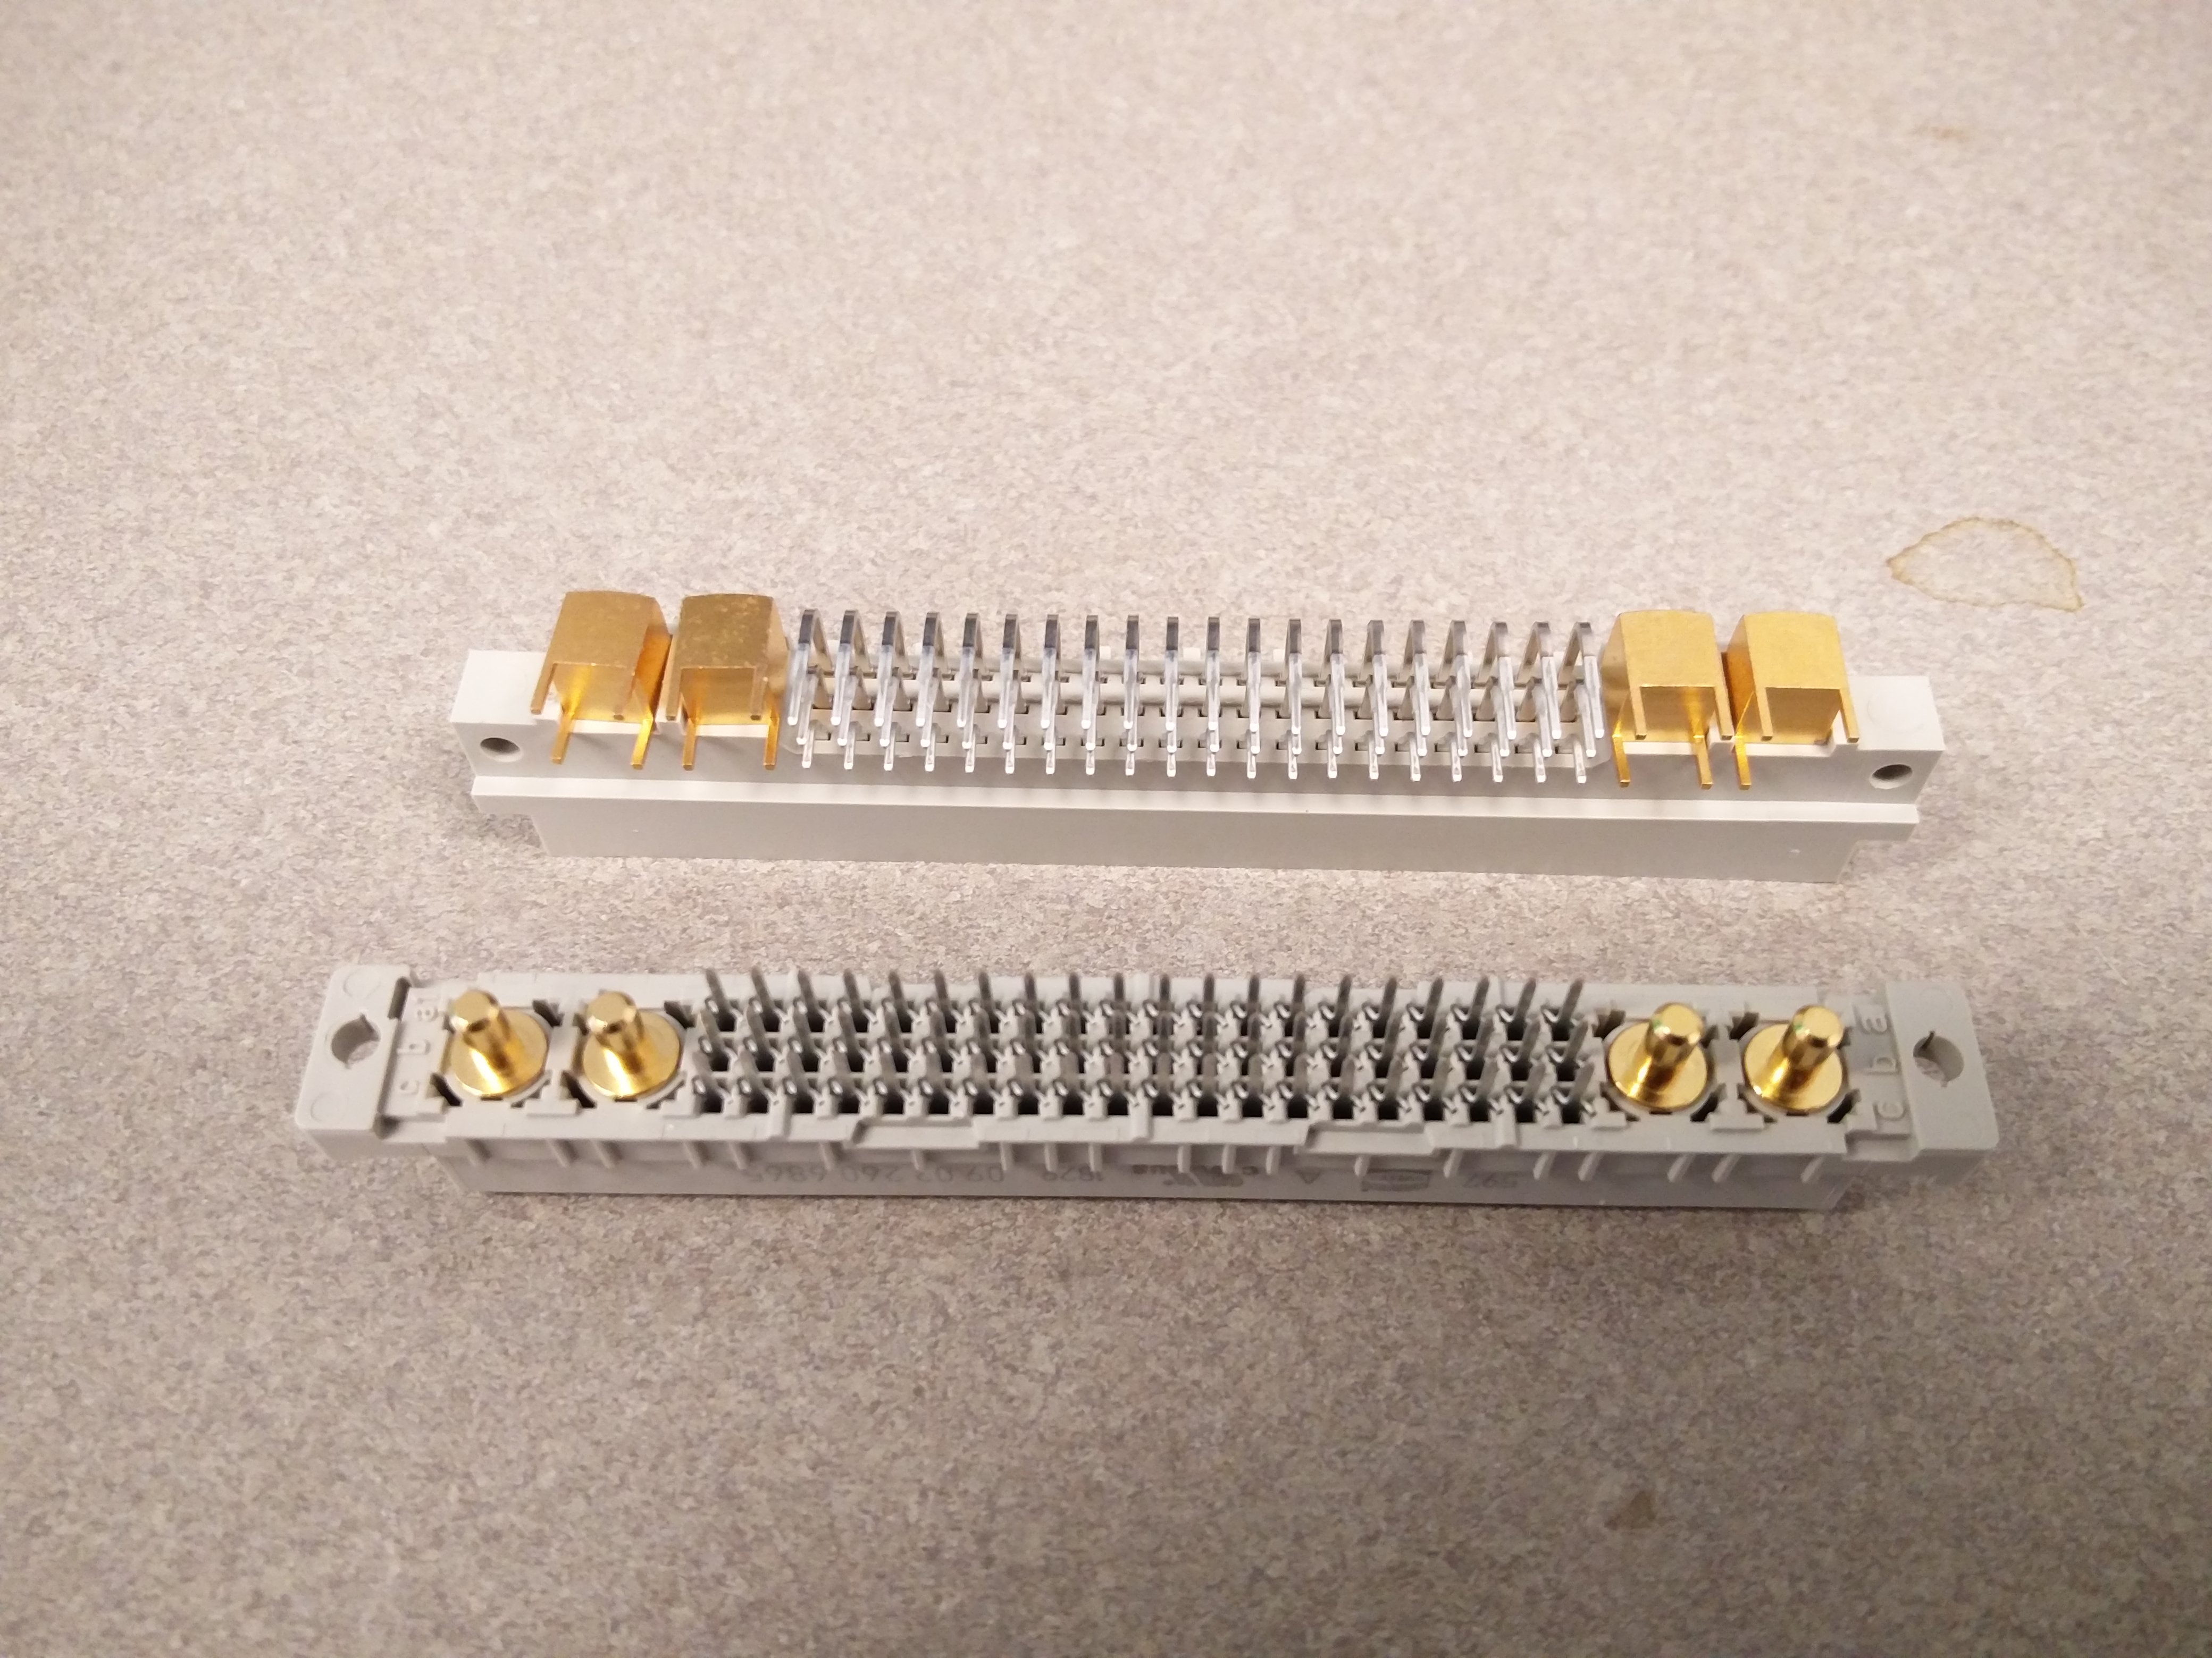
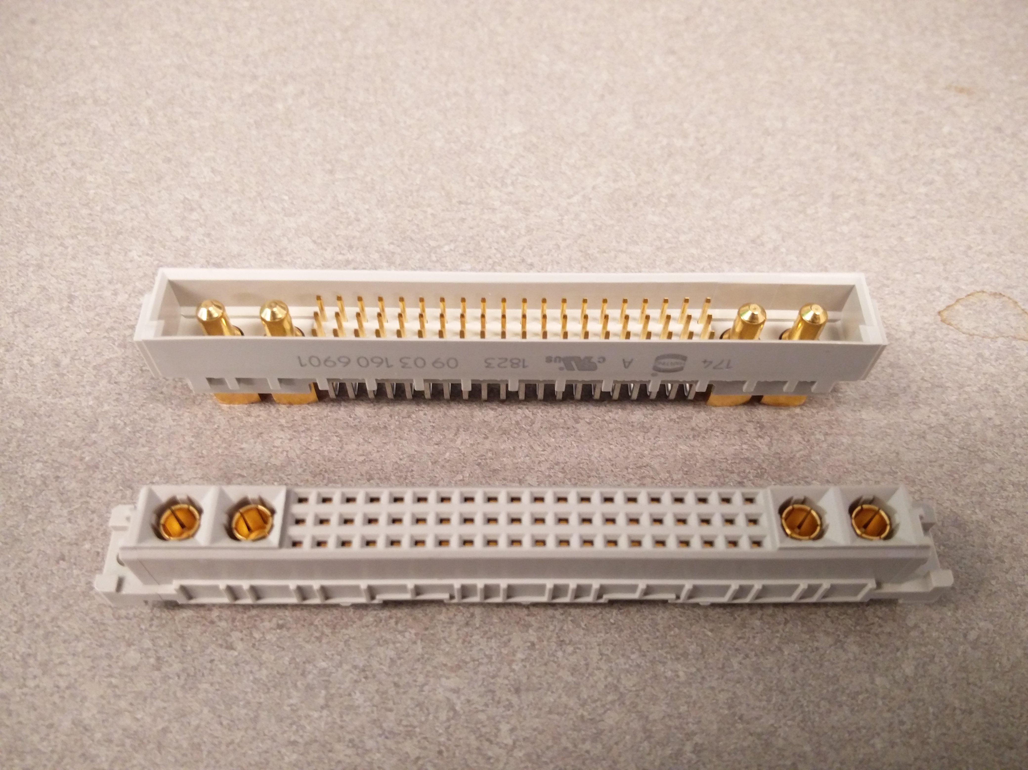
60 Pins @ 2 Amps and 4 High Current Pins @ 20 Amps
Sockets

Slide 6
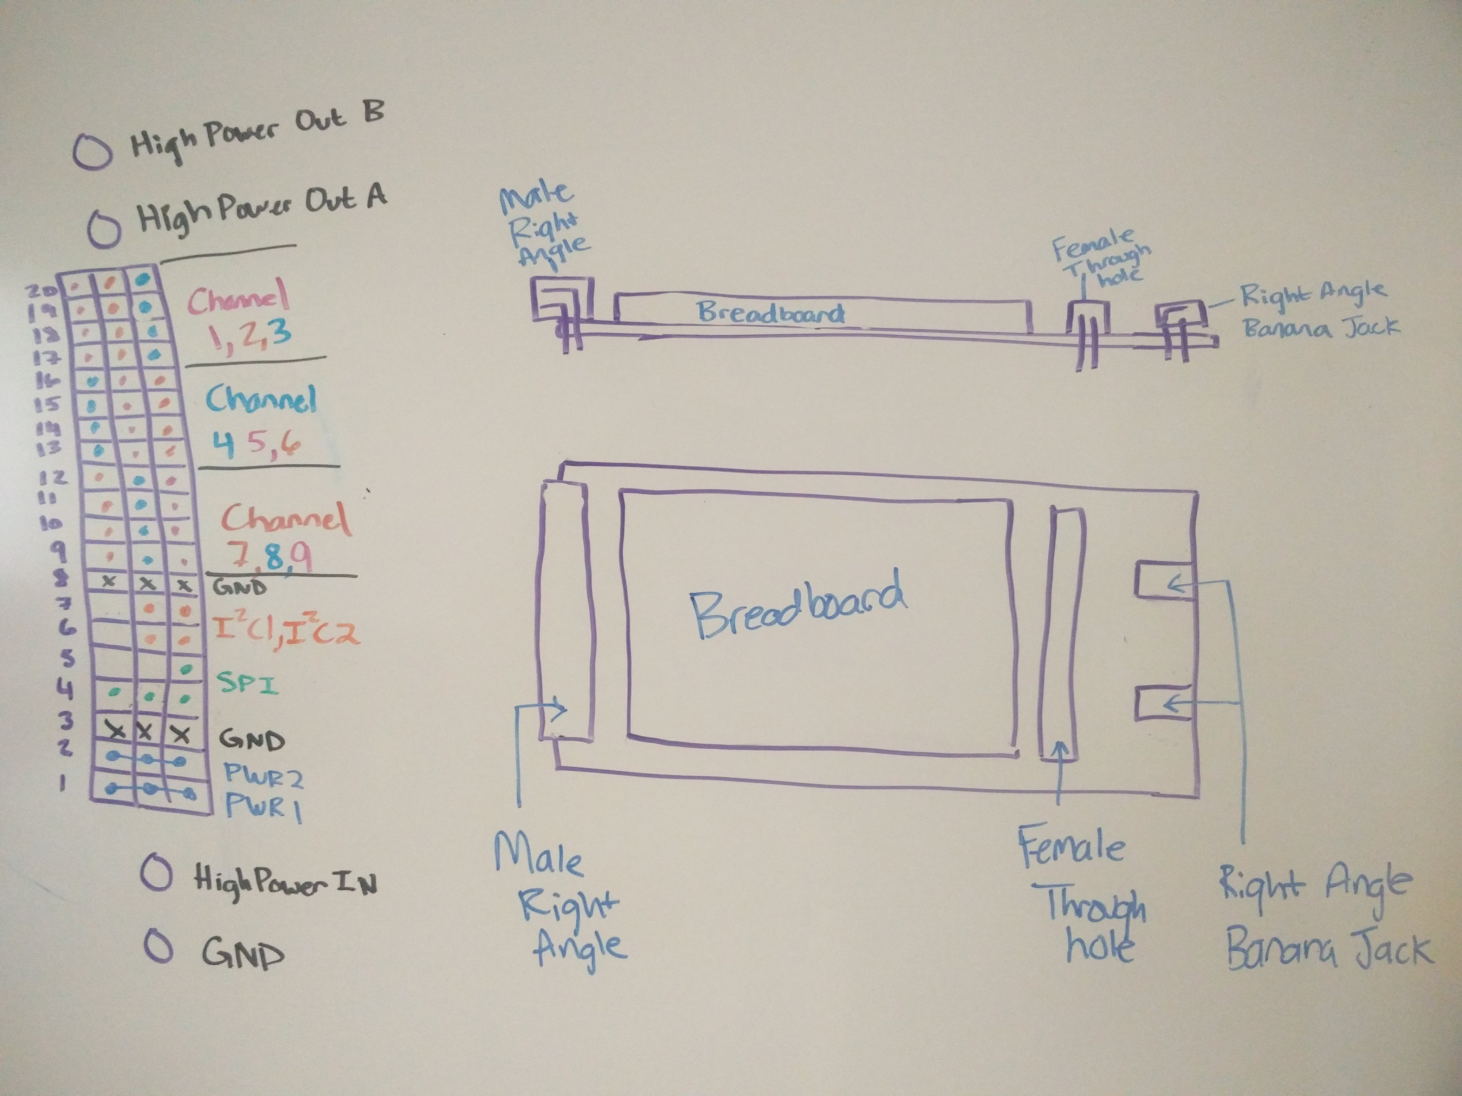
Male Socket, Female Socket, Breadboard, High Power Banana Jacks, Double Length For Easy Access
Prototyping Card (P-Card)
Sketch

Slide 7
Male Socket, Female Socket, Breadboard, High Power Banana Jacks, Double Length For Easy Access
Prototyping Card (P-Card)
Sketch

Slide 8
Male Socket, Female Socket, Breadboard, High Power Banana Jacks, Double Length For Easy Access
Prototyping Card (P-Card)
Sketch
High Power IO
4-pin IO Channels
x9
External Connections/Standalone
Communications
2 I2C Channels
Parallel SPI
Interrupts
Low Power Input
High Power Input

Slide 9
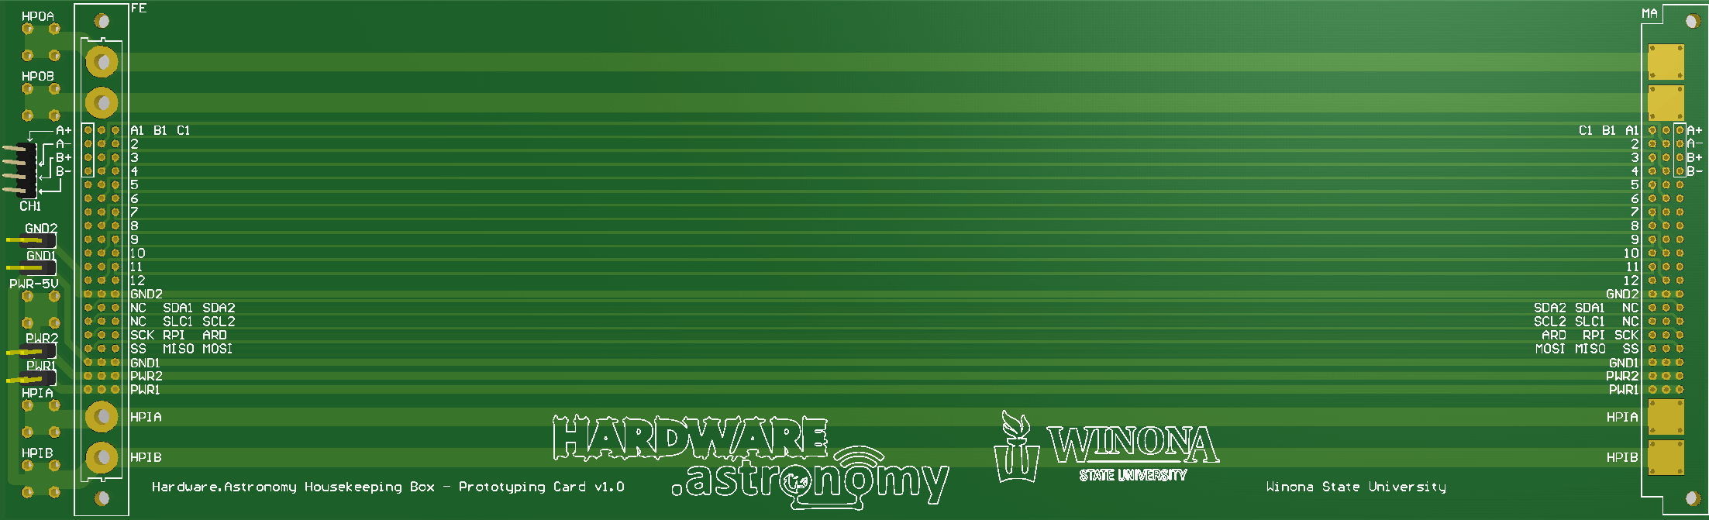
IO Channel
Sockets
High Power IO
High Power Input
Space For
Solderless Breadboard(s)
Low Power Jumpers
P-Card PCB

Slide 10
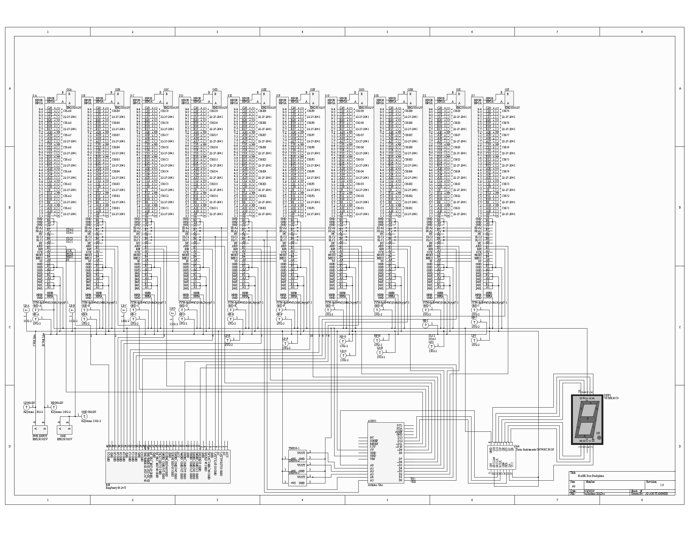
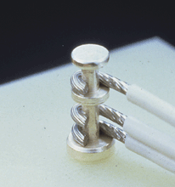
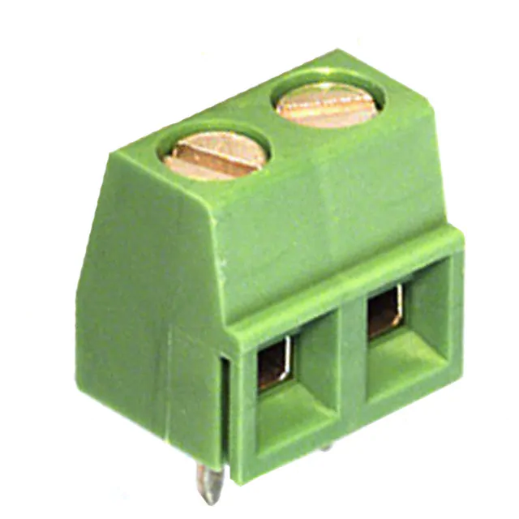
High Power IO
Backplane
Schematic
4-pin IO
Parallel SPI
High Power Turret Terminals
Error Display
Temp Sensors
Power Input
Microcontrollers

Slide 11
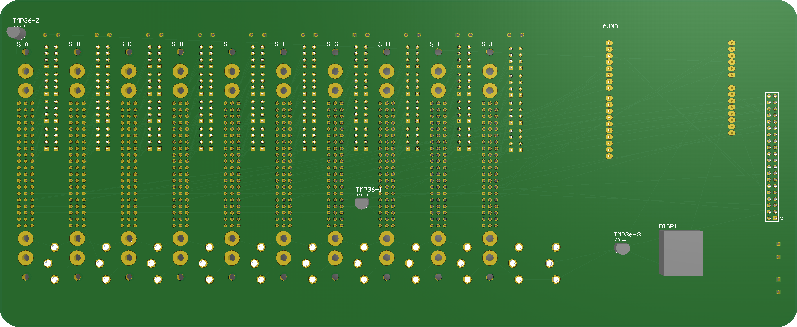
10 Card Sockets
Low Power IO
High Power IO
Arduino Socket
Raspberry Pi Connector
Power Input
Error Display
Turret Terminals
Temp Sensor

Slide 12
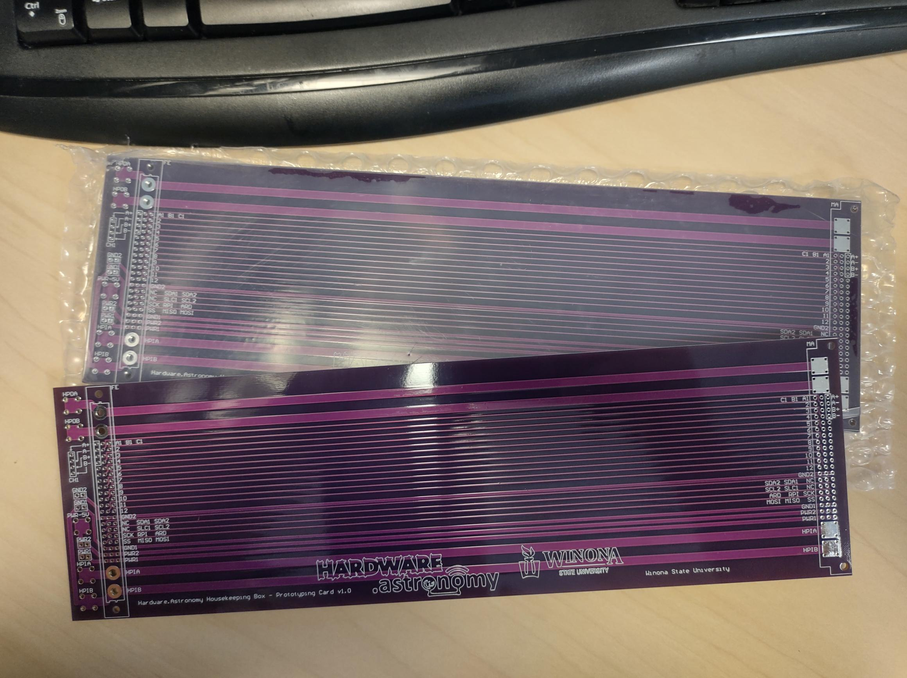

Slide 13
On Board Communications
Logistical Header | Source Card Type | [Data Frame 1] | [Data Frame 2] | [Data …] | [Data Frame n]
0 4 8 16 24 n
Logistical Header:
Logistical Request → (0x0) Used to poll slaves for information.
Logistical Response → (0x1) Responds to Logistical Request. Followed by yes/no data frame.
Error → (0x2) Used to report an error.
Data → (0x3) Used to send non-logistical data.
Logistical Request Format
0b0000 | Source Card Type
0 4 8
Logistical Response Format
0b0001 | Source Card Type | (0b0 / 0b1) , Buffer Size
0 4 8 16
Error
0b0010 | Source Card Type | Error Type
0 4 8 16

Slide 14
Finish Backplane PCB Design
Manufacture
Program Controllers
Finish Daughtercard Designs
Next Steps

Slide 15
Questions?

Slide 16

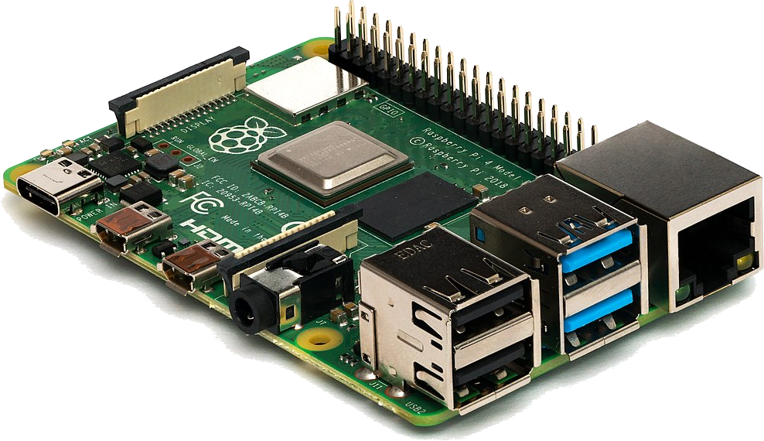

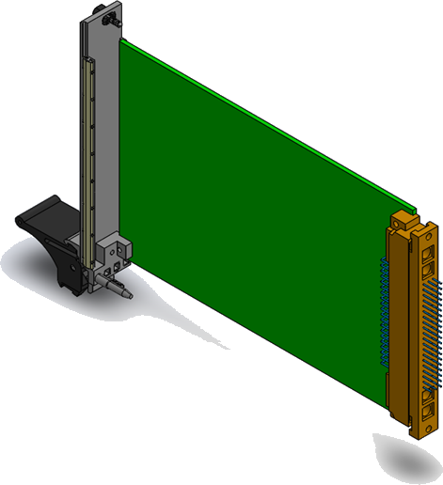
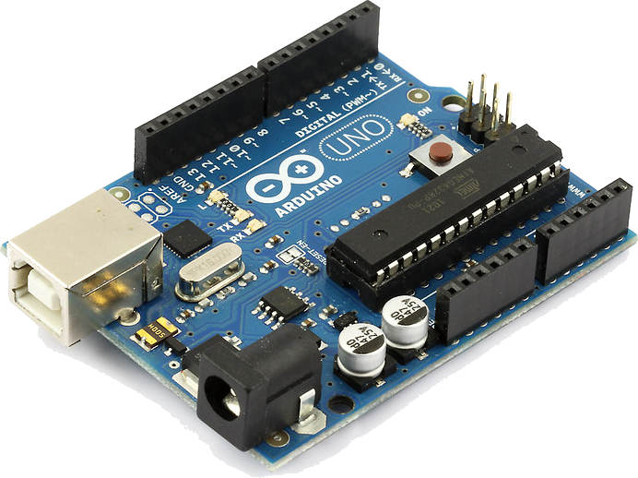

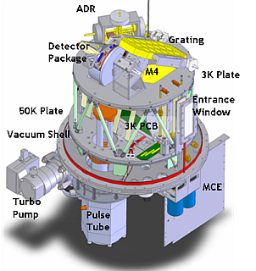

Touchscreen
Raspberry Pi
Microcontrollers
Communication Example
-200°C
Cooler Controller
ZEUS2
Arduino
Temperature Sensor

